Slide 1


Max Hamel
9/2/2025

Slide 2

Outline
Executive Summary
Introduction
Methodology
Results
Conclusion
Appendix

Slide 3
Executive Summary
This research and analysis tries to determine if the first stage rocket will have a successful landing, and the factors involved with doing so. This will help determine the cost of a successful launch. Below is a summary of the methods used to reach the conclusions shown in the rest of this presentation.
Summary of methodologies
Data Collection & Wrangling: Data was collected with the SpaceX REST API and web scraping, then cleaned and formatted to use in the rest of the analysis.
Exploratory Analysis: Initial exploratory analysis was done with SQL and visuals considering factors such as launch sites, payload mass, booster versions and mission outcome
Visualizations: The data was visualized using Folium Lab and Plotly Dash, illustrating launch site locations and outcomes on geographic maps. An Interactive dashboard was created visualizing the percentage of launches for all sites, with payload masses and booster versions.
Predictive Analysis: Machine learning models were trained and tested to predict if the first stage landings are successful. The models used were logistic regression, support vector machines, decision tree classifier and K-nearest neighbor.
Results:
Over time, the number of successful launches has increased. Launch site KSC LC-39A had the highest success rate. The following orbits also had a 100% success rate: ES-L1, GEO, HEO and SSO.
With the machine learning models, all 4 performed quite similarly, with the decision tree performing slightly better than the others.

Slide 4
Introduction
Background
SpaceX is a world leader in the space industry, with the goal to make space travel more affordable for everyone. They regularly launch spacecraft into orbit and the International Space Station, along with successfully launching a satellite internet constellation called Starlink, which can be seen in the night sky. One reason for SpaceX’s success is the relatively inexpensive cost of their rocket launches compared to other providers, with a Falcon 9 launch costing around $62 million dollars vs. $165+ million dollars from competitors. SpaceX can offer such a steep discount because they can reuse the first stage rockets. This analysis seeks to predict the success of the first stage landing and therefore aid in determining the cost of launches.
Goals
Determine how factors such as payload mass, launch site, number of flights, landing type and orbits impact the landing success
Calculate the rate of successful landings over time
Train and test various machine learning models to find the best model to use to predict successful landings

Slide 5

Section 1

Slide 6
Methodology
Executive Summary
Data collection methodology:
Completed using the SpaceX REST API and web scraping
Perform data wrangling
After gathering the data, it was cleaned, filtered for Falcon 9 launches and placed into a Pandas dataframe
Perform exploratory data analysis (EDA) using visualization and SQL
Perform interactive visual analytics using Folium and Plotly Dash
Perform predictive analysis using classification models
Four models were built, trained and tested to predict future landing outcomes

Slide 7
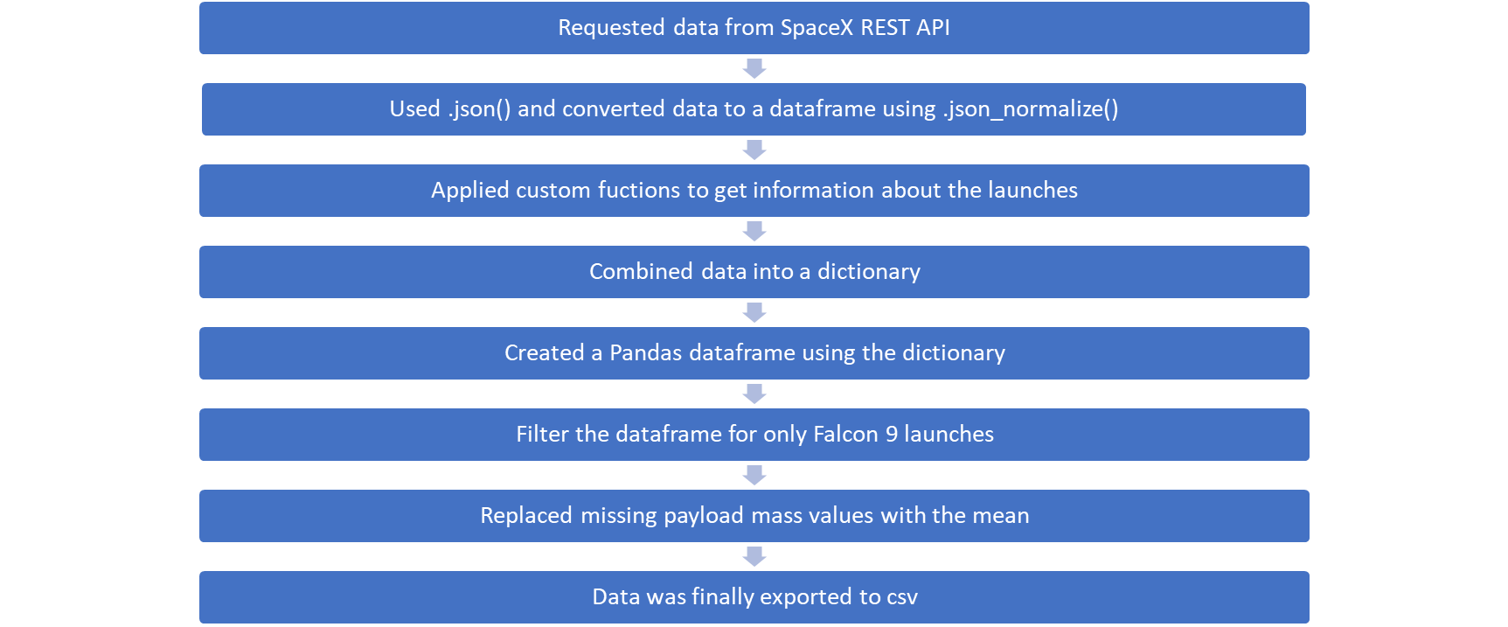
Data Collection – SpaceX API Overview
https://github.com/Max45848/IBM-Data-Science-Capstone-Project/blob/main/jupyter-labs-spacex-data-collection-api.ipynb

Slide 8
Data Collection – Scraping Overview
Requested Falcon 9 data from Wikipedia using requests.get()
Created Beautiful Soup object from the HTML response
Extracted all column/header names from the HTML table header using soup.find_all()
Extracted the column names by iterating through the <th> elements
Created a dictionary from the extracted column names
Created a Pandas dataframe with the dictionary
Data was exported to csv
https://github.com/Max45848/IBM-Data-Science-Capstone-Project/blob/main/jupyter-labs-webscraping-bak-2025-09-02-19-42-04Z%20(1).ipynb

Slide 9
Data Wrangling
Loaded dataset from previous steps using pd.read_csv(), Identified missing values and which columns are numerical or categorical
Calculated # of launches at each site, # of orbit types and occurences, # of mission outcomes and occurences outcomes for each orbit type using the method value._counts()
Created a bad_outcomes set using the following types of landing outcomes: False ASDS, False Ocean, False RTLS, None ASDS and None None
Created a landing outcome label from the outcome column and bad_outcomes set using a loop with an if/else statement, the results were then assigned to the variable landing_class, column name Class. 1 = successful outcome 0 = bad outcome
df["Class"].mean() was then used to calculate a success rate of roughly 66.67%
https://github.com/Max45848/IBM-Data-Science-Capstone-Project/blob/main/labs-jupyter-spacex-Data%20wrangling.ipynb

Slide 10
EDA with Data Visualization
Charts
Scatter Point
Help visualize the relationships between the X and Y variables. Identifying relationships between variables could useful for machine learning models
Flight Number and Payload Mass
Flight Number and Launch Site
Payload Mass and Launch Site
Bar Chart
Shows comparison between categories and a value
Orbit Type and Success Rate
Line Chart
Displays the change in a variable over a period of time
Year and Success Rate
https://github.com/Max45848/IBM-Data-Science-Capstone-Project/blob/main/edadataviz.ipynb

Slide 11
EDA with SQL
Queries
Displayed list of unique launch site names
Displayed 5 records where the launch site began with “CCA”
Summed the total payload mass carried by NASA launched boosters
Calculated average payload mass carried by F9 v1.1 boosters
Listed the date of the first successful ground pad landing
Listed the boosters that have had successful drone ship landings with a payload mass between 4000 and 6000
Listed each mission outcome and the number of occurrences for each
Displayed all booster versions that have carried the maximum payload mass
Listed records along with month names for each month in the year 2015
Ranked count of landing outcomes between June 4th 2010 and March 20th 2017 in descending order
https://github.com/Max45848/IBM-Data-Science-Capstone-Project/blob/main/jupyter-labs-eda-sql-coursera_sqllite.ipynb

Slide 12
Build an Interactive Map with Folium
Started by marking NASA Johnson Space Center’s coordinates on the map with a pop label showing its name and a blue circle
Added markers for all launch sites with red circles and a popup label
Launch outcome markers were added for the launch sites color coded green for successful outcomes and red for unsuccessful outcomes
Distance from CCAFS SLC-40 and its closest coastline, railway, highway and city were calculated, and lines were added to the map.
https://github.com/Max45848/IBM-Data-Science-Capstone-Project/blob/main/Interactive%20visual%20analytics%20with%20folium%20lab.ipynb

Slide 13
Build a Dashboard with Plotly Dash
Added a dropdown input component for the launch sites to allow users to select all or a specific site to filter the dashboard by
Created a pie chart with a callback function based on the site selected in the dropdown, that displays successful and unsuccessful launches as a percent of total
Added a range slider of payload mass between 1000 and 10,000 kg. Filters the other visuals as well
Created a scatter chart with a callback function displaying payload mass vs. success rate, based on the launch site selected
https://github.com/Max45848/IBM-Data-Science-Capstone-Project/blob/main/plotly%20dash%20code.txt

Slide 14
Predictive Analysis (Classification)
Created a Numpy array from the Class column by applying to_numpy()
Standardized the data with a transform StandardScaler
Split the data into training and test data using train_test_split
Created a GridSearchCV object to find the best parameters
GridSearchCV was then applied to each of the models, LogReg, Support Vector Machine, Decision Tree and K Nearest Neighbor
Accuracy was calculated for each model type and plotted on a confusion matrix for each
The best model was identified comparing the results of these matrices
https://github.com/Max45848/IBM-Data-Science-Capstone-Project/blob/main/SpaceX_Machine%20Learning%20Prediction_Part_5.ipynb

Slide 15
Results
Exploratory data analysis results
Launch success has improved over time
The site with the highest success rate was found to be KSC LC-39A
Orbits ES-L1, GEO, HEO and SSO had 100% success rates
Interactive analytics demo in screenshots
Launch sites are located near the equator to take advantage of the Earth’s rotational speed. They are near the coastline and far enough from population centers to reduce change of damage in the event of failed launches
Predictive analysis results
All four models had similar results, however the decision tree was the best model overall

Slide 16

Section 2

Slide 17
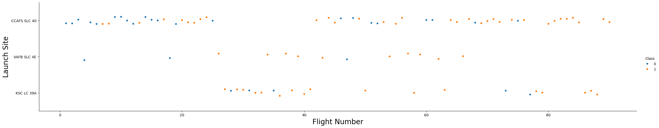
Flight Number vs. Launch Site
Successful launches increased over time
Most launches were from CCAFS SLC 40

Slide 18
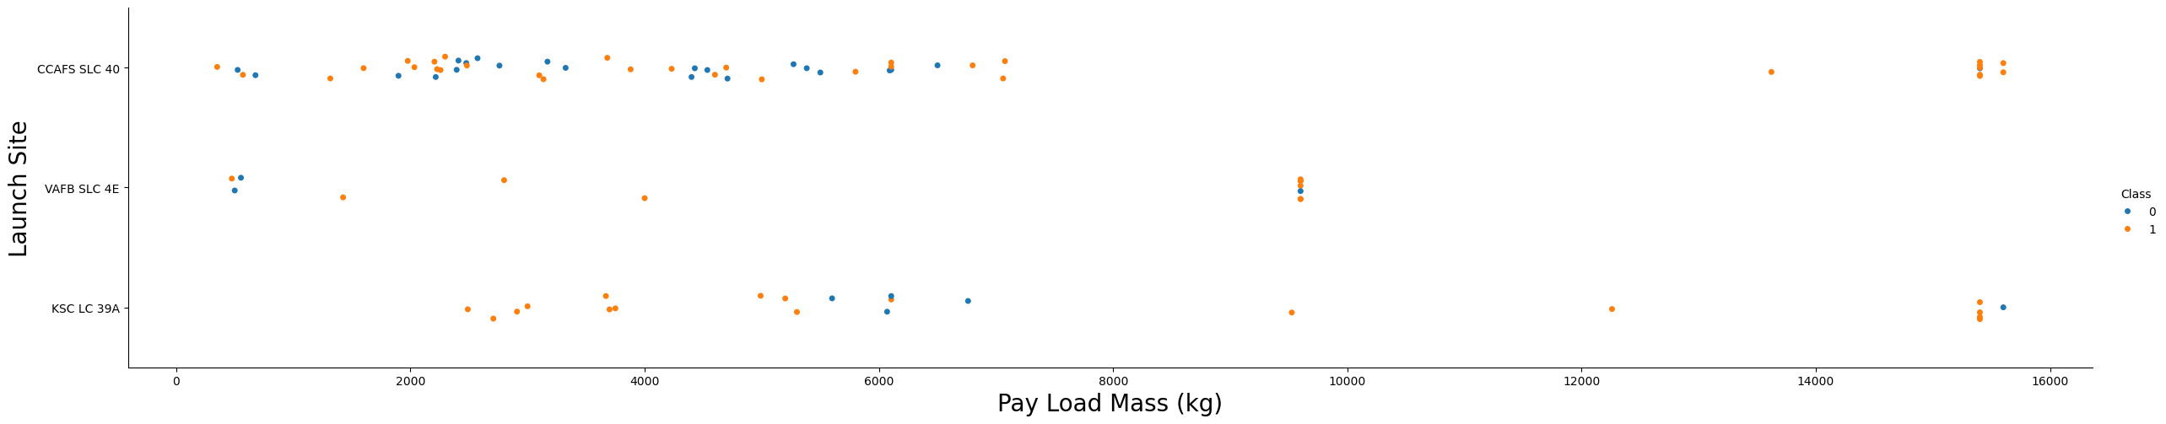
Payload vs. Launch Site
Success rate appears to increase with payload mass
The majority of launches were below 8000 kg
VAFB SLC 4E had no launches over 10,000 kg

Slide 19
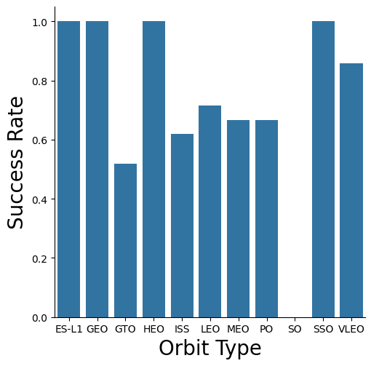
Success Rate vs. Orbit Type
ES-L1, GEO, HEO and SSO had 100% success rates
Most other orbits had around 60-80% success rates
GTO was below 60%, where as SO had a 0% success rate

Slide 20
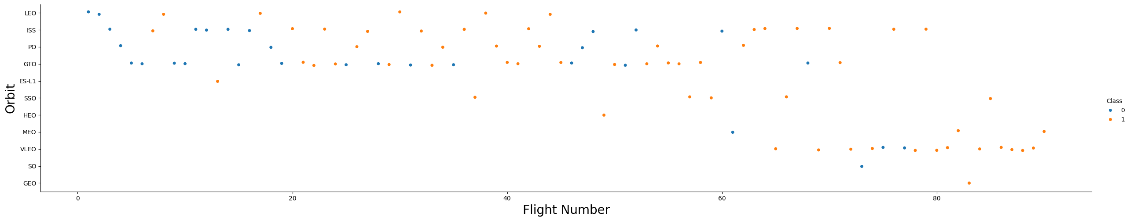
Flight Number vs. Orbit Type
Successful orbits appear to increase over time
Additional orbit types appear over time as well, especially around flight number 60

Slide 21
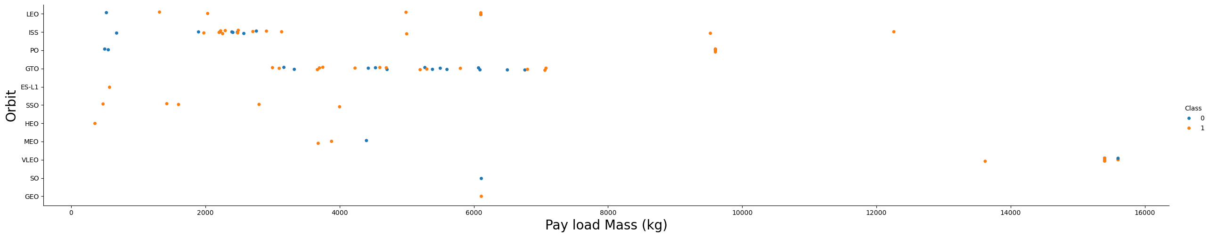
Payload vs. Orbit Type
Certain payload masses favor different orbit types
Such as GTO from roughly 3000 to 7000 kg and the ISS from 2000 to under 4000 kg

Slide 22
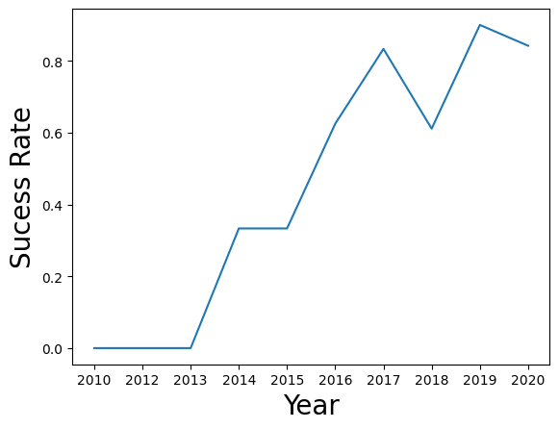
Launch Success Yearly Trend
Launch success rate saw a sharp increase from 2013 to about 2017
From 2017-18 a temporary decrease in success rate occurred before leveling back out

Slide 23
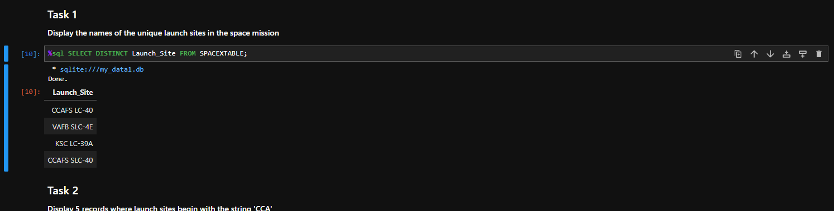
All Launch Site Names
Launch Sites
All distinct names from database table

Slide 24
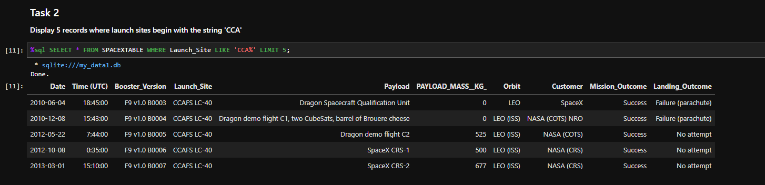
Launch Site Names Begin with 'CCA'
Displayed first 5 rows where launch site starts with CCA

Slide 25
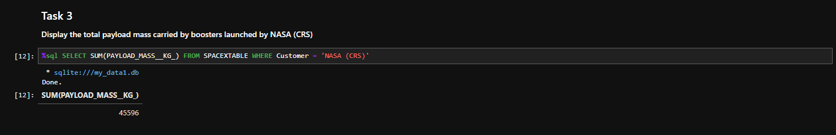
Total Payload Mass
Summed payload mass where customer = NASA CRS
45,596 kg

Slide 26
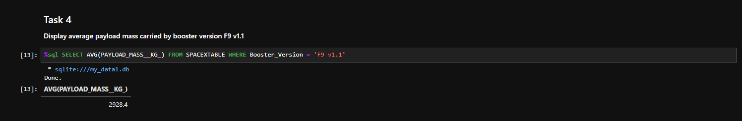
Average Payload Mass by F9 v1.1
Average payload mass = 2928.40 kg

Slide 27
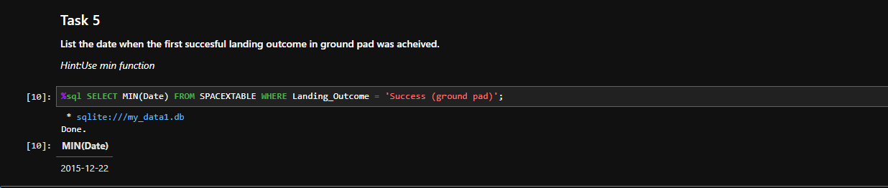
First Successful Ground Landing Date
First ground pad success was December 22nd, 2015

Slide 28
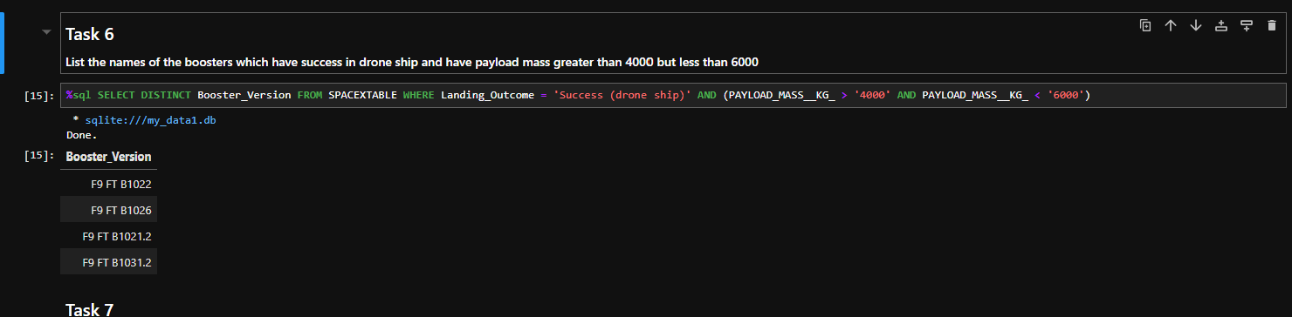
Successful Drone Ship Landing with Payload between 4000 and 6000
Boosters with successful drone ship landings with payloads between 4000 and 6000:
F9 FT B1022
F9 FT B1026
F9 FT B1021.2
F9 FT B1031.2

Slide 29
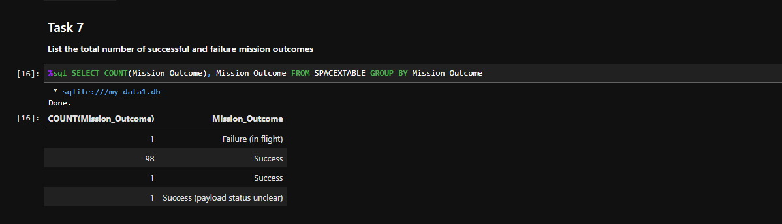
Total Number of Successful and Failure Mission Outcomes
By far most missions result in success based on mission outcome

Slide 30
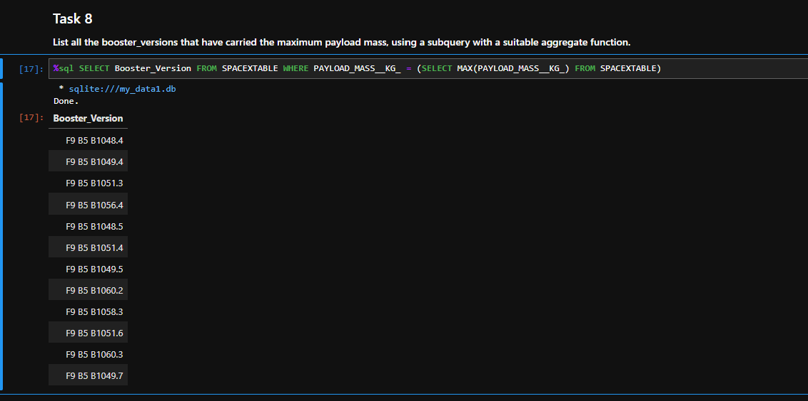
Boosters Carried Maximum Payload
Filtered the SPACEXTABLE for only payload masses that equal the maximum amount in the table

Slide 31
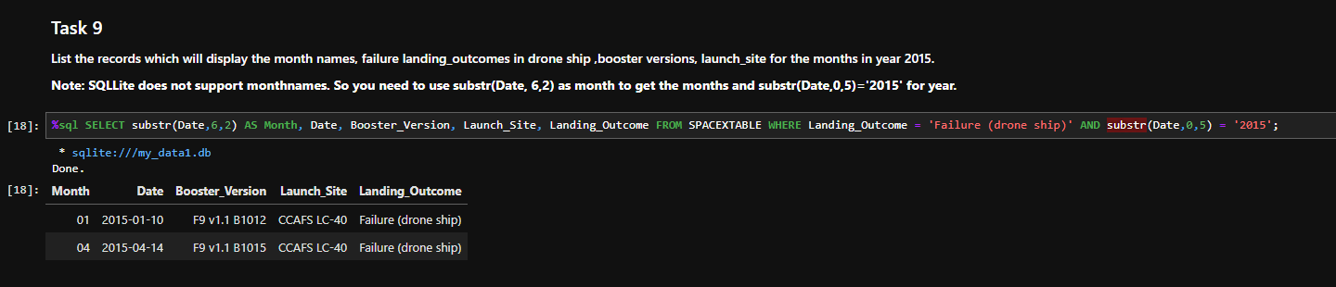
2015 Launch Records
There were failed drone ship landings in January and April of 2015

Slide 32
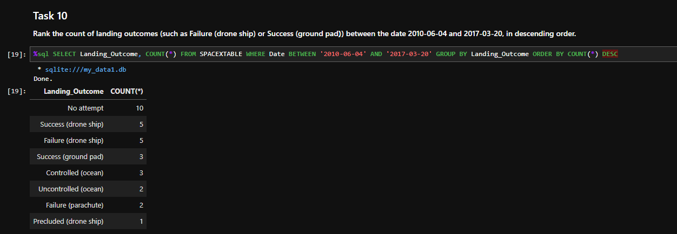
Rank Landing Outcomes Between 2010-06-04 and 2017-03-20
No attempt had the highest occurrence rate, with second place tied with drone ship successes and failures

Slide 33

Section 3

Slide 34
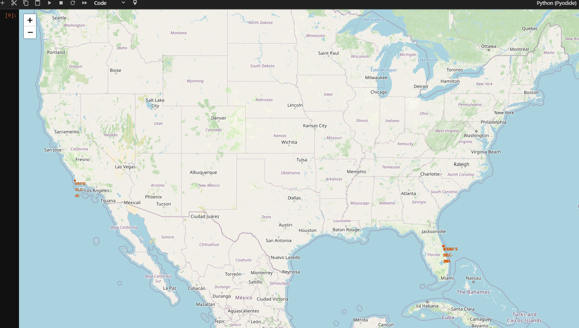
Launch Sites with Markers
Markers with labels were placed on all launch sites
Launch sites tend to be near the equator to use the Earth’s rotational speed for additional speed while exiting the atmosphere, which therefore can save costs

Slide 35
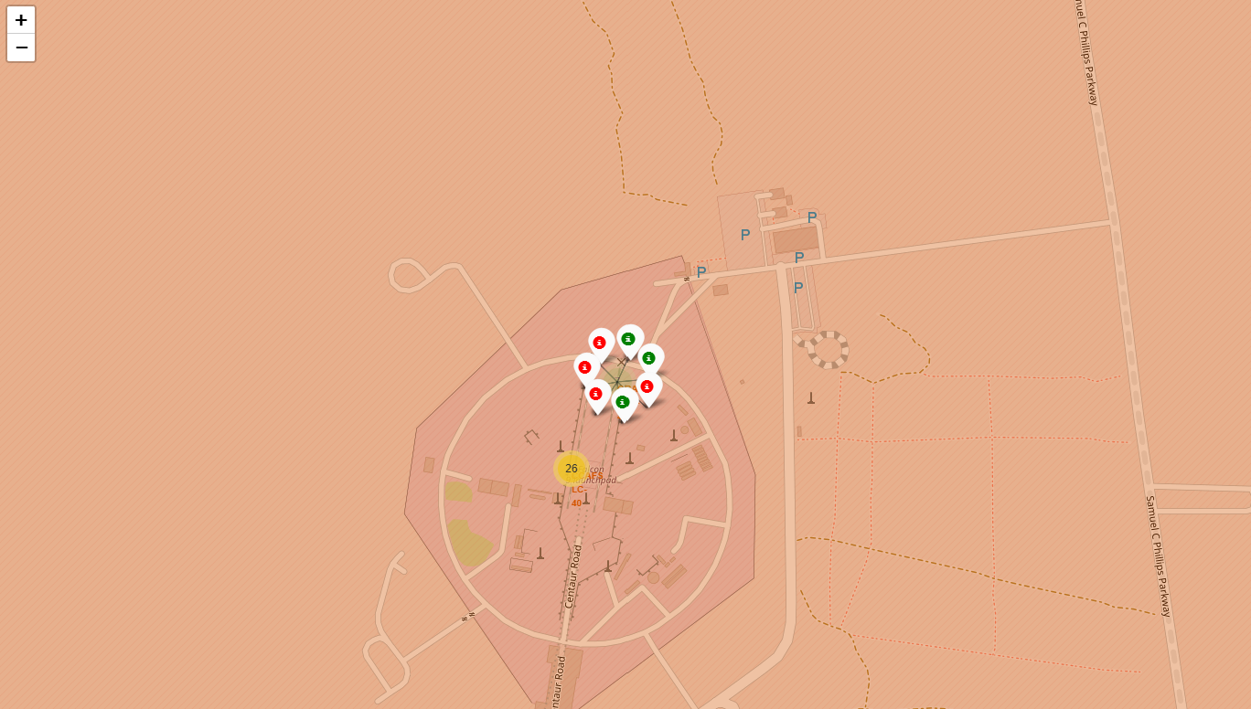
Launch Outcomes
Each launch site has pop up markers for launch outcomes
Green = successful
Red = unsuccessful

Slide 36
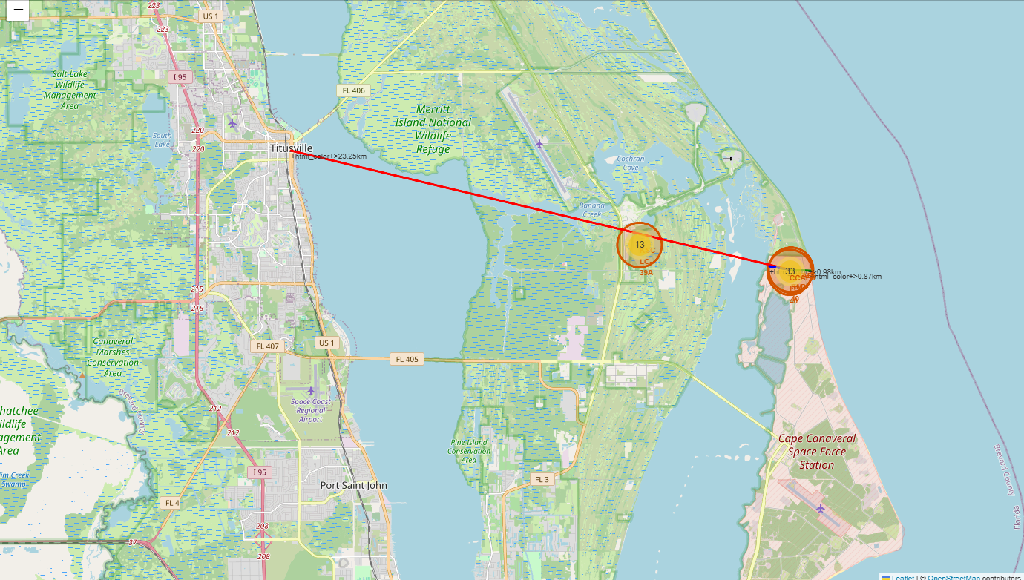
Distance to Proximities
Colored lines are added to denote the distance to the near city, railway, highway and coastline
Red = City
Blue = Railway/Highway
Green = Coastline
Launch sites tend to be far enough from population centers, roads and railways to avoid safety issues during unsuccessful launches/landings but close enough to be able to ship in material and people who work there

Slide 37

Section 4

Slide 38
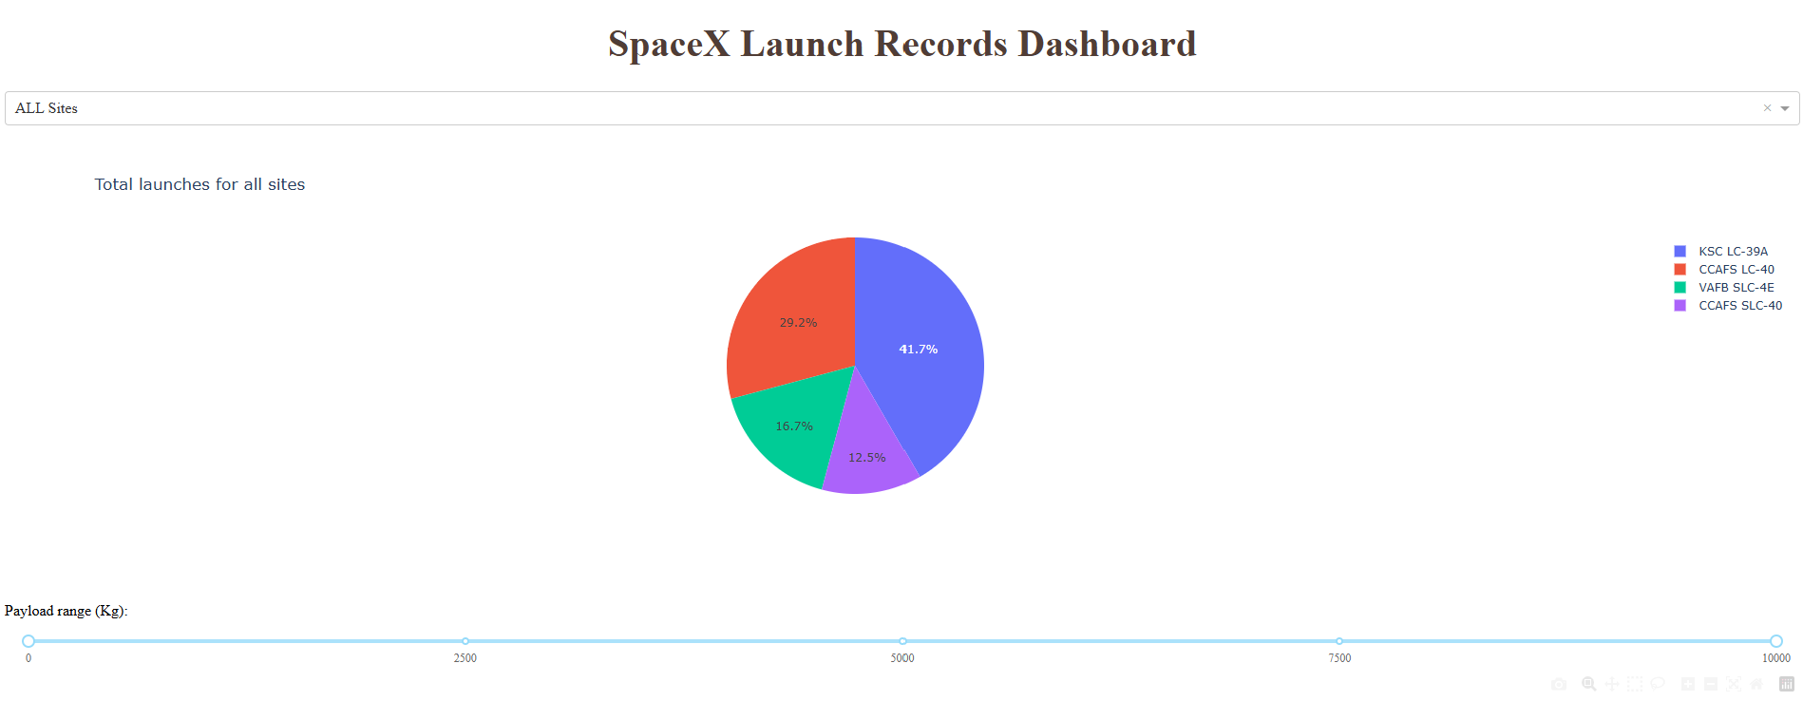
Success Rates by Launch Site
KSC LC-39A was the site with the highest success rate at 41.7%

Slide 39
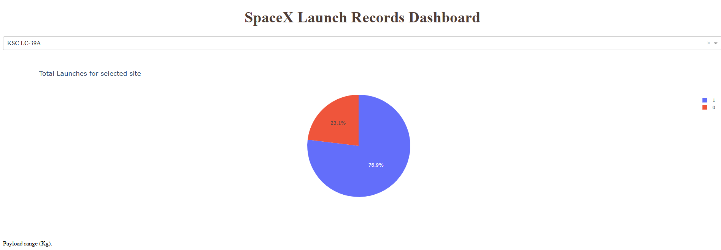
Most Successful Site
KSC LC-39A was the most successful site with 76.9% of its launches resulting in success

Slide 40
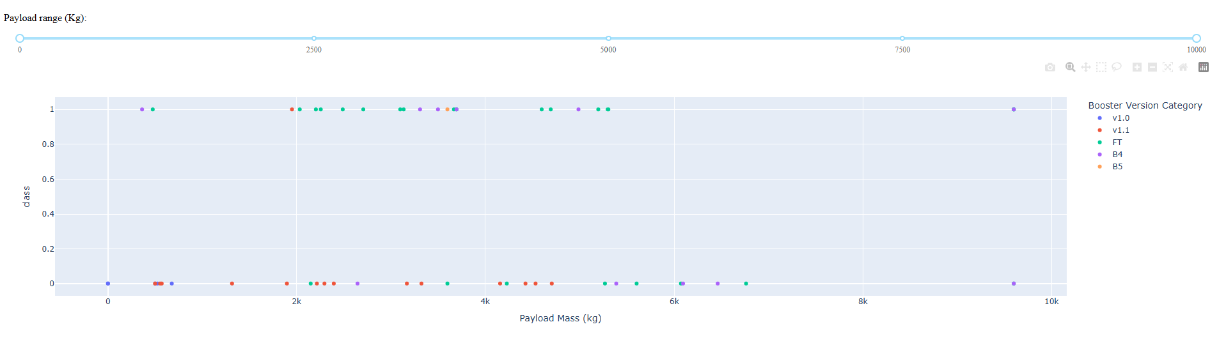
Payload Mass and Mission Success
Most successful launches had payloads between 2000 and under 6000 kg
Booster Version FT appears to have the most successes out of the categories
1 = successful 0 = unsuccessful

Slide 41

Section 5

Slide 42
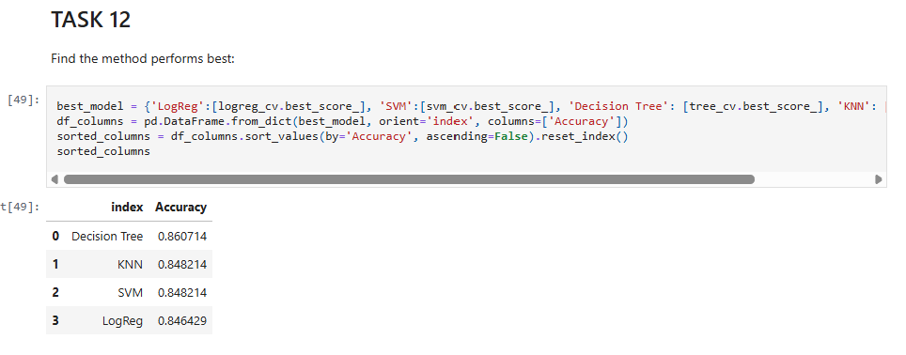
Classification Accuracy
All four models performed quite closely, but the decision tree had the highest accuracy of the four models at around 86%

Slide 43

Confusion Matrix
The Decision tree confusion matrix
True Positives = 12
True Negatives = 3
False Positives = 3
False Negatives = 0
Precision = 12 / (12 + 3) = .8
Recall = 12 / (12 + 0) = 1
Accuracy = (12 + 3) / (12 + 3 + 3 + 0) = .83

Slide 44
Conclusions
Launch success has improved over time
The site with the highest success rate was found to be KSC LC-39A
Orbits ES-L1, GEO, HEO and SSO had 100% success rates
Launch sites are located near the equator to take advantage of the Earth’s rotational speed. They are near the coastline and far enough from population centers to reduce change of damage in the event of failed launches, yet close enough to ship in people and material for work
All four machine learning models had similar results, however the decision tree was the best model overall
Considerations:
The data set is somewhat small and could have an impact on the results of this analysis
Other features may be considered to be included in future analysis to help improve model accuracy if possible

Slide 45


